Slide 1
The
Standard
Template
Library
...
Written by Rachel J. Morris, last updated 1/6/17

Slide 2
Topics:
The Standard Template Library
Vectors
Lists
Stacks
Queues
Maps

Slide 3
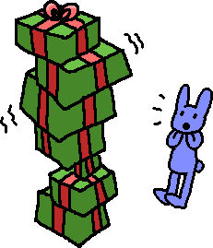
Introduction
C++ has some data structures already pre-built and available within the standard library that we can use to get familiar a bit with how these structures work.
Before we get into the details of implementing these data structures, it might be useful to see how they can actually be used first…

Slide 4

Introduction
Wait, if data structures already exist, why are we going to spend all semester learning how to write ‘em?!

Slide 5
Introduction
Wait, if data structures already exist, why are we going to spend all semester learning how to write ‘em?!
Well… learning about data structures & algorithm analysis is a big part of computer science.
You also need to know the inner-workings of these structures, so that when you’re implementing solutions, you can choose the best structure for your particular problem – it isn’t one size fits all!

Slide 6
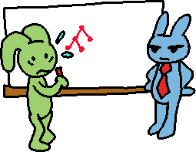
Introduction
Wait, if data structures already exist, why are we going to spend all semester learning how to write ‘em?!
You might need to create your own data structures down the line, or customize an existing one!
You’ll be asked about them during job interviews. Interviewers love asking about data structures.

Slide 7
Introduction
So let’s see how some of these structures work by utilizing the structures available in the Standard Template Library.
In particular…
STL Vector
STL List
STL Stack
STL Queue
STL Map

Slide 8
STL Vector

Slide 9
STL Vector
In some ways, vector objects are similar to arrays, which you may have used in previous classes.
You can access specific items of the vector with the subscript operator, [ ]

Slide 10
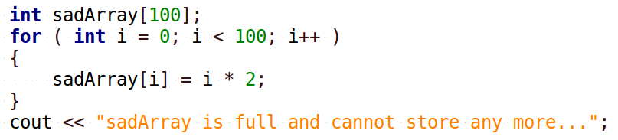
STL Vector
A perk of the vector object is that it handles resizing on its own.
Recall that with a static array, we had to know what its size was at compile time, and it couldn’t be resized!

Slide 11
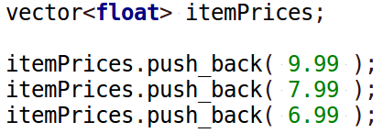
STL Vector
With a STL vector, it handles resizing on its own (behind-the-scenes!), so we don’t have to worry about it – we can just keep adding items on to it!
Now we’re the “other programmer”, and we don’t really care how it’s implemented, we just care that it works!
The vector’s push_back function is how we add items into the “array”.

Slide 12
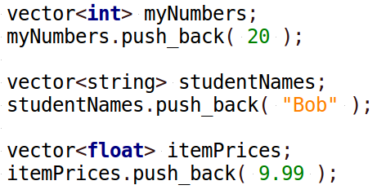
STL Vector
A Vector can store any data-type.

Slide 13
STL Vector
A Vector can store any data-type.
The <int>, <string>, and <float> bits of code are because vector has been implemented as a template.
If you haven’t covered templates before, or don’t quite remember how they work, don’t worry – we will go over them more later on.

Slide 14
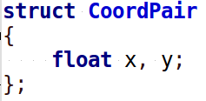
STL Vector
A Vector can store any data-type.
If we write a struct or a class, a vector can even store those!

Slide 15
STL Vector
Some handy functions of a vector are…
push_back
Insert an item at the end of the vector
size
Returns the amount of items in the vector
empty
Returns whether the vector is empty or not (size == 0?)
operator[]
Access an item in the vector at any index
clear
Clears out all the elements of the vector.

Slide 16
STL Vector
Let’s try it out!

Slide 17
STL List

Slide 18
STL List
Lists also store a linear series of data, but they’re a little different from vectors.
For one, you cannot randomly access data with the subscript operator [ ].
Generally, to step through a list, you have to start at the beginning and keep stepping through, one at a time.
The STL List does contain a sort() function and reverse() function, though!

Slide 19
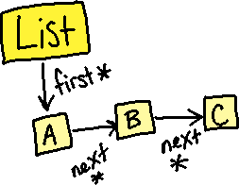
STL List
We cannot randomly access data in a List because it isn’t implemented with an array, like vector is.
STL Lists use pointers. The list keeps track of what its starting element is, and each element points to the next element in the list.
Therefore, unlike an array, the elements are not in contiguous memory slots.
(This is why it’s important to stay familiar with pointers for this class!)

Slide 20
STL List
We will discuss the pointer and memory aspect of lists later on, once we’re implementing linked lists.
For now…
onto the STL List functionality!

Slide 21
STL List
push_back
Insert an item at the end of the list
size
Returns the amount of items in the list
empty
Returns whether the list is empty or not (size == 0?)
clear
Clears out all the elements of the list.
sort
Sorts the elements of the list
reverse
Reverses the order of elements in the list.

Slide 22
STL List
Let’s try it out!

Slide 23
STL Stack

Slide 24
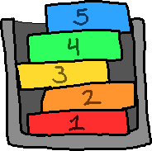
STL Stack
A Stack is a type of data structure that is linear, like a list or vector is, but it also restricts access to the internal data.
The main characteristic of a stack is that it is a
First In Last Out (or) Last In First Out
structure.

Slide 25
STL Stack
At any time, you’re only able to access one item from the stack – the top-most item.
And, as items are pushed onto the stack, the older items are on the bottom, and the newer items are on the top.

Slide 26
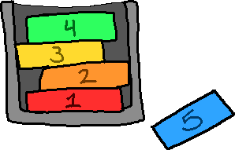
STL Stack
As you remove items from the stack, you pull the newest item that was added to the stack.
The first item on the stack is the last one to be removed.

Slide 27
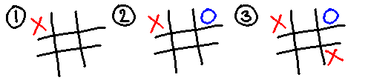
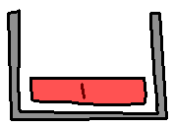
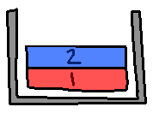
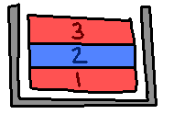
STL Stack
One example of using a Stack is to keep track of moves in a game of tic-tac-toe
Every time a move is made, we could push the game board’s current state onto a stack…

Slide 28
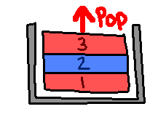
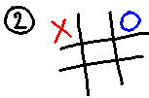
STL Stack
Then if we want to undo a turn, we can pop the most recent state off the stack
And the game board reverts to the state before.

Slide 29
STL Stack
Some handy functions of a stack are…
push
Pushes an item to the top of the stack.
pop
Removes an item from the top of the stack.
top
Returns the item that is at the top of the stack.
size
Returns the amount of items in the stack.
empty
Returns whether the stack is empty or not.

Slide 30
STL Stack
Let’s try it out!

Slide 31
STL Queue

Slide 32
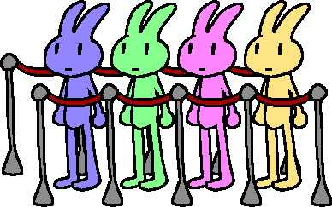
STL Queue
A queue is another kind of restricted-access data structure.
Like a stack, you can only access one item of the queue at a time.
However, a queue is
First In First Out
structure

Slide 33
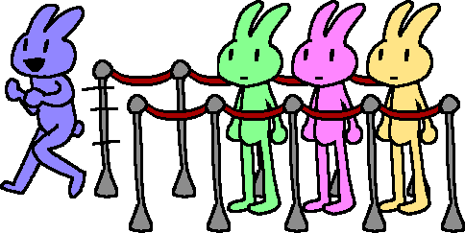
STL Queue
The first item that enters the queue, who sits at the front of the line, is the first one to get removed, just like in a grocery-store line.

Slide 34
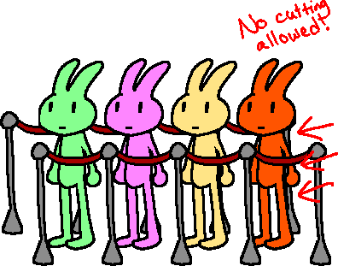
STL Queue
And when a new item is added to the queue, it enters at the end (or back) of the queue.

Slide 35
STL Queue
Some handy functions of a queue are…
push
Pushes an item to the back of the queue.
pop
Removes an item from the front of the queue.
front
Returns the item that is at the front of the queue.
size
Returns the amount of items in the queue.
empty
Returns whether the queue is empty or not.

Slide 36
STL Queue
Let’s try it out!

Slide 37
STL Map

Slide 38

STL Map
When we’re using a plain-old array, we have a series of elements in order, starting at 0, going until (size – 1).
7 items in the array
=
Index 0 through 6 is valid

Slide 39
STL Map
A value of 0, 1, 2, 3, 4, 5, or 6, which specifies an element’s position, is known as an index, but we can also think of it like a “key”,
which helps us locate the value we want
Key
Value

Slide 40
STL Map
But with a data structure like a map, our keys don’t have to just be integers, and they don’t have to be
array indices.
The key can be any data type,
and it can point to a value of any data type as well.

Slide 41
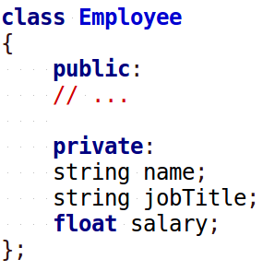
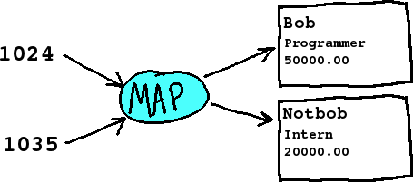
STL Map
For example, think of an
employee ID, that points to
an employee object in a program…
Key
Value

Slide 42
STL Map
Maps are built in a special way so that we can access elements by key, and it will access it quickly – search algorithm not required.
Key
Value

Slide 43
STL Map
Some handy functions of a vector are…
operator[]
Access an element of the map, using a key
insert
Insert a new key-value pair into the map
empty
Returns whether the map is empty or not
size
Get the amount of elements in the map

Slide 44
STL Map
Let’s try it out!

Slide 45
CPlusPlus.com
A really handy page for C++ documentation is
CplusPlus.com
If you look up stuff from the C++ standard library, you will find objects included in the library, functions that those objects have, and example code.
http://www.cplusplus.com/

Slide 46
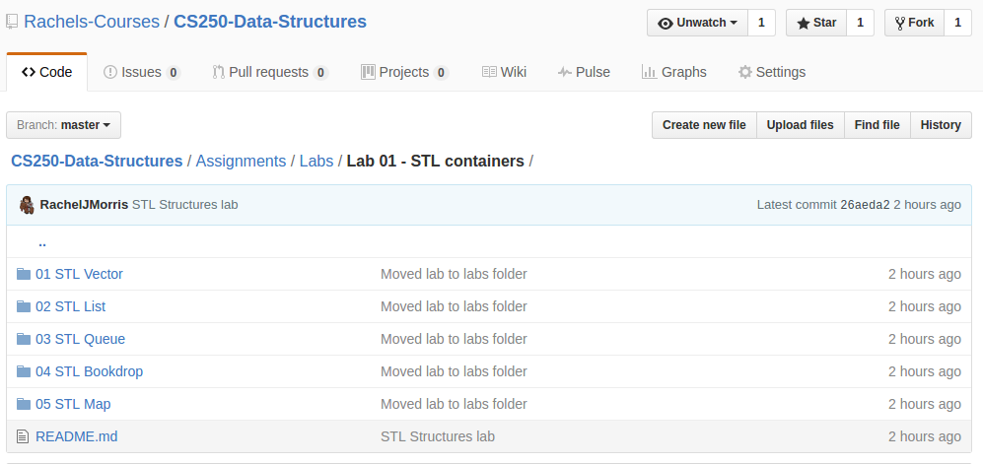
Practice
Make sure to check out the course GitHub for example code and practice projects.
github.com/Rachels-Courses/CS250-Data-Structures

